Slide 1

ProSim
Company Overview
The Premium alternative in Process Simulation
ASPO Seminar
Joëlle Torta, Olivier Baudouin November, 27th, 2013

Slide 2
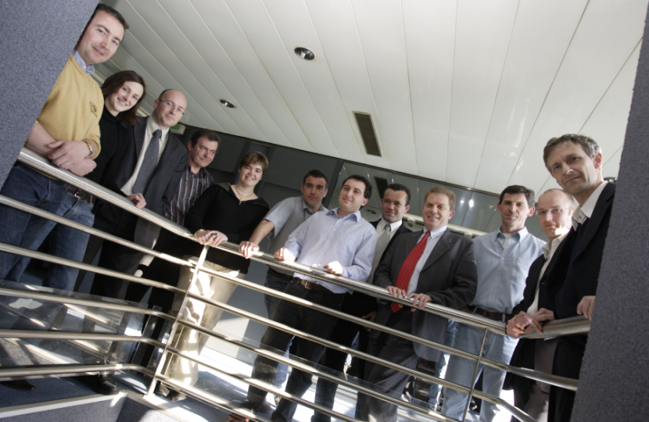
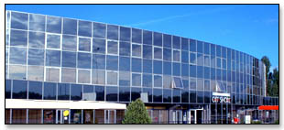
ProSim in a few words
History:
Independent company created in 1989
by Pr. B. Koehret and Pr. X. Joulia
Headquarter in Labège
(Toulouse - France)
Staff
Engineers and doctors in chemical engineering
Engineers in computer science
Strong connections with the ENSIACET
French main public research center in chemical engineering (300 full time Professors or research staff, chemical engineering library...)

Slide 3

Activity: CAPE
(Computer Aided Process Engineering)
Process Engineering Software development and
distribution
  (chemistry, petrochemistry, pharmacy, petroleum, refining, energy…)
Services
  Related to software distribution: MUTS Services
  (Maintenance, Upgrades, Training and Support)
  Studies | Consulting
Research and Development
Notes:
Our activity, CAPE, is divided up in 3 fields, each one representing about 1/3 of ProSim’s turnover.

Slide 4

Two fields of expertise to serve you
Process engineering
  Process modeling, simulation and optimization
  Kinetic parameters fitting
  Equipment sizing and design
  Thermodynamic properties and phase equilibria calculations
  Energy integration and optimization
  Process data management
Software development
  Graphical user interface
  Numerical methods
… constantly strengthened through cooperation with major players of the industry (Total, Arkema, IFP-Axens…) and recognized research centers

Slide 5

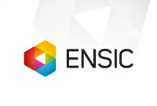




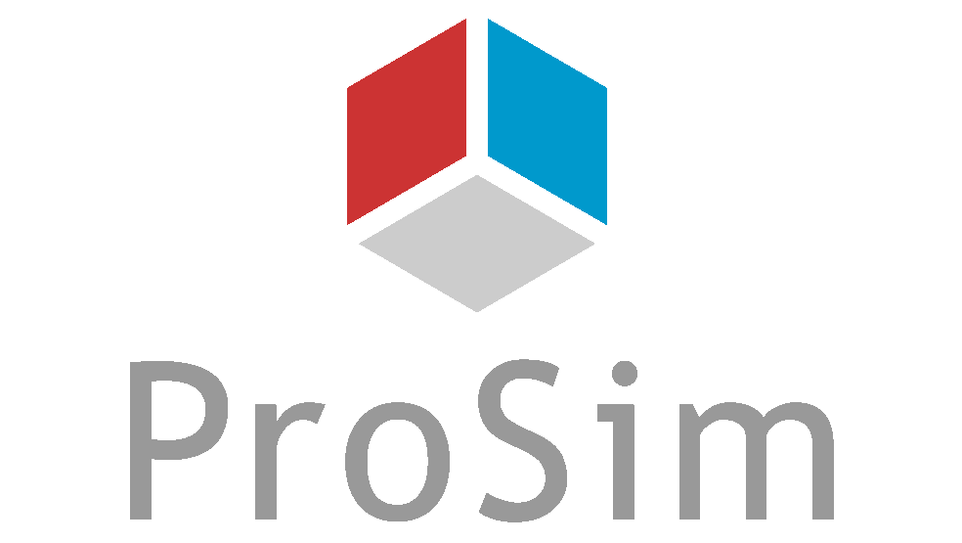









A network of partners
Laboratoire de Chimie Physique
LaTEP
We make the most of R&D resources
to deliver you with commercial results

Slide 6

Huge investments in R&D to maintain the best technology available
Ratio between investments in R&D and turn-over
Notes:
We invest a lot in R&D.
You can see on this chart the ratio …
For comparison purpose, you can note that the R&D investment made by the 500th first companies in the world is about 5% and other process engineering simulation providers une to invest 20% in the better case while we use to be above 30%.

Slide 7



Locations
Toulouse
(France)
Philadelphia
(PA)
Shanghai
(China)
Bangalore
(India)
Over 880 clients in 71 countries

Slide 8
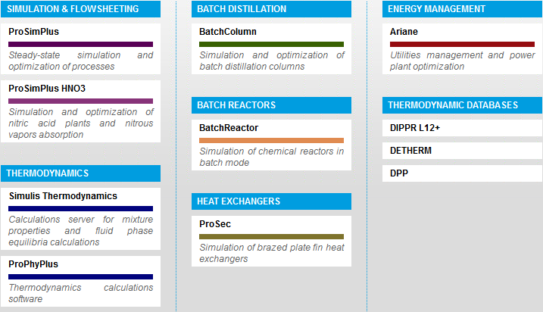
A consistent suite of software
… the premium alternative in process simulation

Slide 9

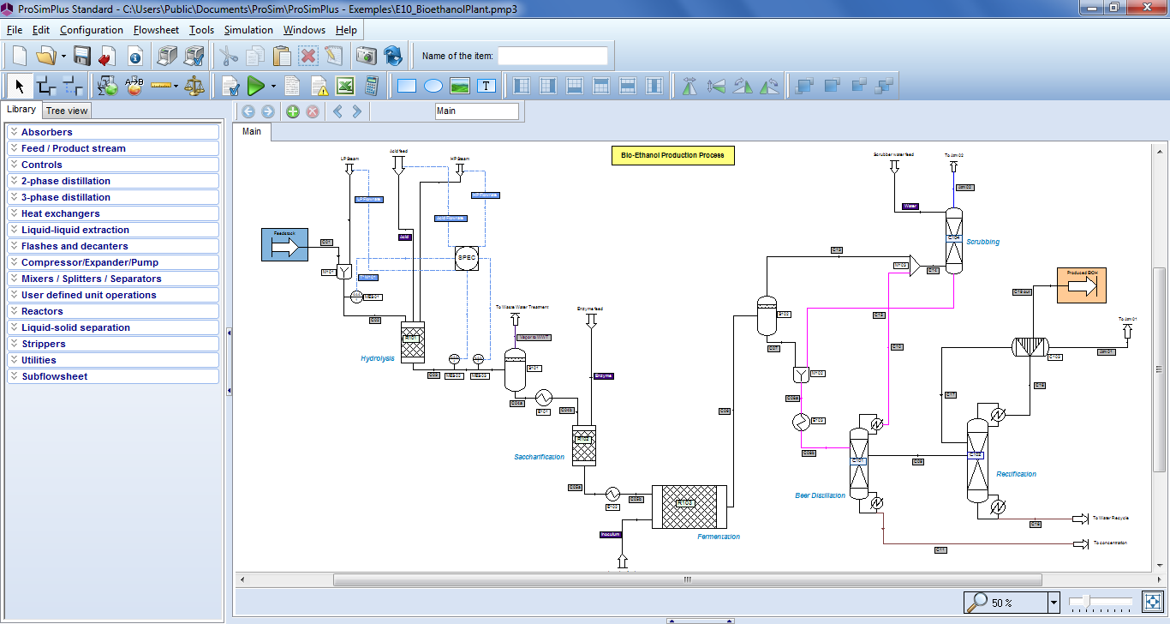
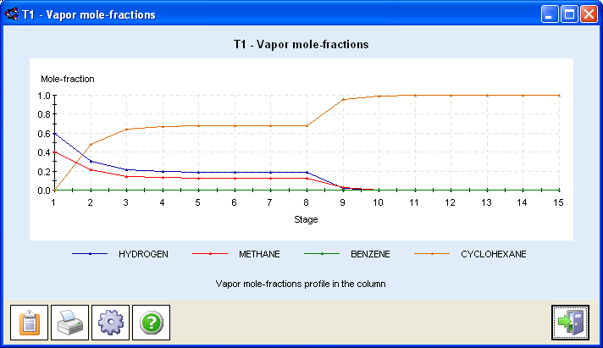
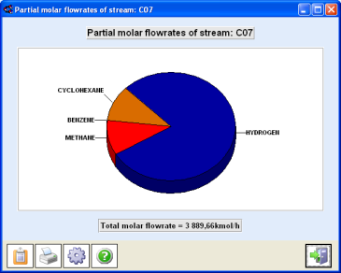
ProSimPlus
General steady-state process simulation
Besides usual unit operations, you'll find specific ones: "Rate-Based" approach, plate-fin heat exchangers, three-phase and reactive distillation,…
Reliable convergence methods
Open system (CAPE-OPEN, VBScripts,…)
Easy-to-use
Extensive possibilities for inputs and outputs
A widely validated software
Notes:
Tout d'abord ProSimPlus, notre simulateur général de procédés continus en régime permanent.
⇨
Ce n'est malheureusement pas le seul produit sur le marché puisqu'il s'agit d'outils dont l'usage est devenu maintenant très banalisé.
Ce qui fait la spécificité de ProSimPlus, hormis le fait que c'est le seul produit français ce sont certaines fonctionnalités que l'on ne va pas retrouver ailleurs.
⇨
Un module pour le calcul des colonnes de séparation multi-étagées, éventuellement réactives par étage de non équilibre : "Rate-Based Approach" chez nos amis anglo-saxons
Parmi les spécificités de ProSim, on peut également citer ses capacités d'optimisation et l'existence d'une version spécifique pour les unités de production d'acide nitrique : ProSimPlus HNO3 qui renferme un gros savoir-faire dans ce domaine et en particulier sur l'oxydo-absorption de vapeurs nitreuses. Certains d'entre vous utilisent ce logiciel.
ProSimPlus renferme également un module pour la simulation des échangeurs compacts multi-passes et multi-fluides. Il s'agit d'échangeurs de chaleur assez complexes qui sont utilisés principalement en cryogénie ou sur des procédés de liquéfaction de gaz.

Slide 10

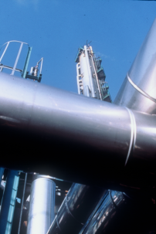
ProSimPlus HNO3
Why a specific software?
Complexity of physical and chemical phenomena:
  Chemical reactions in gas phase in nearly all the parts of the process
  Liquid phase chemical reactions
  Gas-liquid interface complex phenomena
  Thermodynamic properties not easy to model
Very specific equipment:
  Absorption column,
  Oxidation volumes,
  Nitrogen oxides cooler/condenser,…
Export Steam (15 bars)
Gas separator
Reactor
Ammonia
RGQ4
Process Water
Condensate
Eco
Steam
Turbine
Air
RGQ3
Boiler
Feed Water
Air
Compressor.
RGQ1
Condenser
PEA
Nearly impossible with a general purpose flowsheeting program
Nox
Compressor
Condenser
Bleacher
Tail Gaz
Turbine
Absorption tower
Nitric
Acid 60%
RGQ2

Slide 11
ProSimPlus HNO3
Why a specific software?
Standard process simulator
Nitric Acid process
ProSimPlus HNO3
  Volume of pipes are in fact oxidation volumes
  Sizing of pipes is not taken into account in the design phase
  A specific unit operation is used
  Gas phase nitrogen oxide reactions take place in all the equipment
  Chemical reactions need to be described at the level of each piece of equipment
  Chemical reactions (gas and liquid) are already coded in all the unit operations
  Absorption column involves complex phenomena
  Absorption column is simulated with standard equilibrium stage model
  Absorption column is simulated with specific model
  Space between plates is in fact gas phase chemical reactor
  Column sizing parameters are not taken into account in design
  Absorption column takes into account all the phenomena
  …
  …
  …

Slide 12
ProSimPlus HNO3
Why a specific software?
1st possible approach:
Development of “in-house” specific codes for the main unit operations
  Not very flexible
  Poor efficiency when looking at the global flowsheet
  Maintenance issues
2nd possible approach:
Use of general purpose process simulation software
  Requires a very good knowledge of the involved phenomena as well as excellent modeling skills
  Simplification of the problem because the general simulator does not aim to model the HNO3 process specificities
  Very hard and expensive development and validation phases
3rd possible approach:
Use a validated specific process simulator ProSimPlus HNO3

Slide 13
ProSimPlus HNO3
Why a specific software?
  PhD Thesis of Prof. Xavier JOULIA, 1981:
  “Contribution au Développement d’un programme général de simulation – Application à l’analyse du fonctionnement d’un atelier de production d’acide nitrique”
> 25 years of experience in nitric acid plants & nitrous vapors absorption columns modeling
This know-how has been regularly updated, enriched, validated and implemented in ProSimPlus HNO3

Slide 14
A consistent suite of software
… the premium alternative in process simulation

Slide 15



Simulis Thermodynamics
Software component for physical properties calculation
The kernel of all our thermo physical properties calculations
Easy plug in any application
(MS-Excel®, MATLAB®, C++,…)
Extensive set of services (flash, data regression, phase envelopes, etc)
Fully CAPE-OPEN compliant
External software
able to generate
CO packages
(Aspen Properties, Multiflash, PPDS,…)
Your
Software
MS-Excel
ProSimPlus,
MATLAB, etc
External
CAPE-OPEN
Property
Package
Simulis®
Thermodynamics

Slide 16
A consistent suite of software
… the premium alternative in process simulation

Slide 17


BatchColumn & BatchReactor
Industrial Issues
Software applications
Short «time to market» products
Pressure on production cost (increased competition, ROI…)
Change of productions in the same plant
Safety concerns
Environmental concerns
No available «rules of thumb» due to complex phenomena
...
Process development: scale-up from laboratory bench to pilot then full-scale plants, operating procedure revision…
Process optimization: testing of new operating procedure, new equipment, new components…
Feasibility studies: using / adapting an existing column to a new process…
Cost reduction: optimization of operating conditions, reflux policy…
Environmental impact analysis: level of VOC emission evaluation, process waste reduction...
…

Slide 18

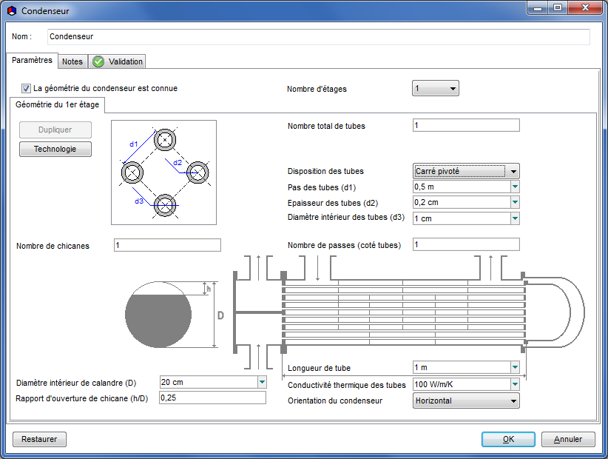
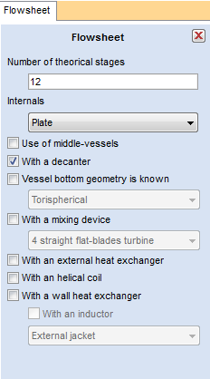
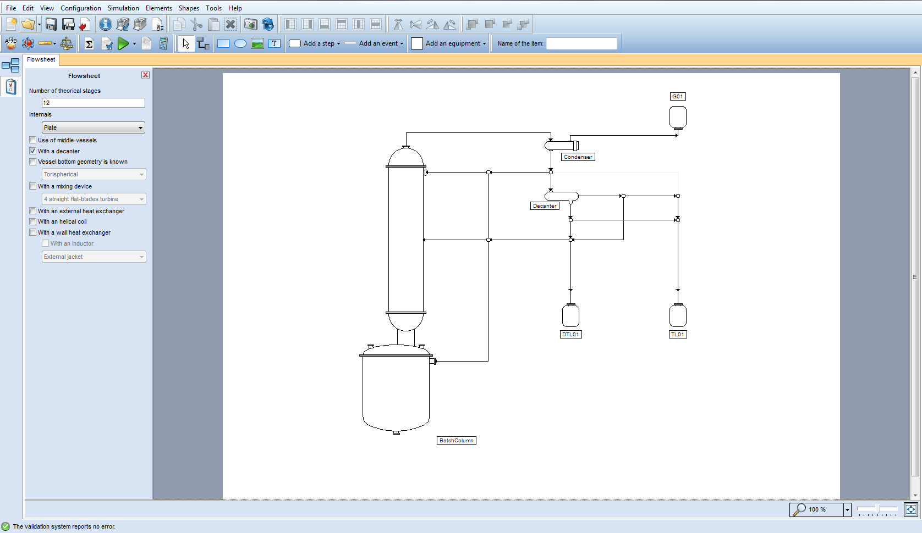
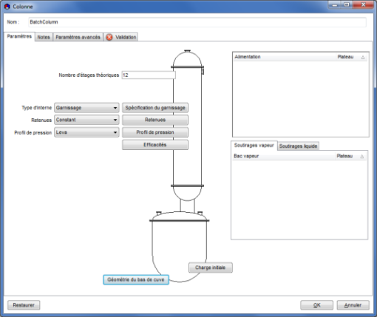
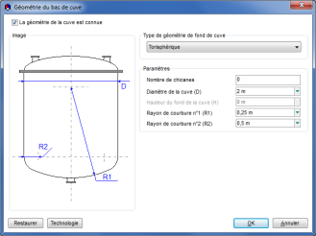
BatchColumn
Reliable Description of the Operating Recipe
Condenser
1 or 2 condensation stages
Rigorous calculation of heat exchange coefficient
Thermal fluid choice
Non-condensable calculations
Decanter
Constant or variable level
Decanter featuring reflux phase selection
Decanter total or partial by-pass
Possible specific thermodynamic model

Slide 19
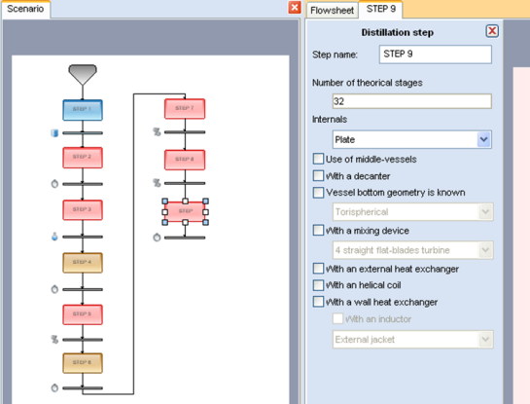
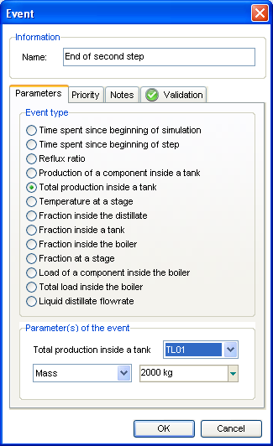
BatchColumn
Different types of operating steps
Filling-up of the column
    From a steady state
    From infinite or finite reflux
Fixed reflux distillation
Variable reflux distillation (given purity in one of the components at the distillate)
Infinite reflux (the distillate is sent back to the
top of the column)
Finite reflux (the distillate is sent back to the boiler)
  … automatically sequenced as an event is detected
  (time, temperature, composition, production,
  reflux ratio…)

Slide 20
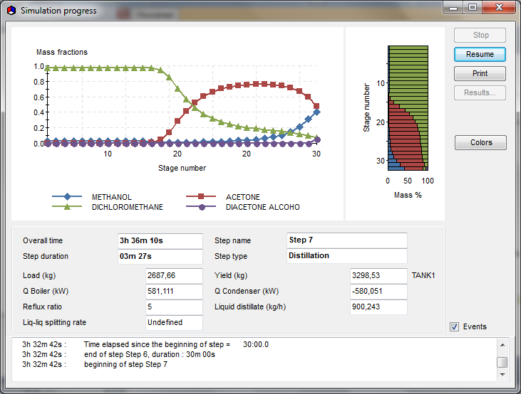
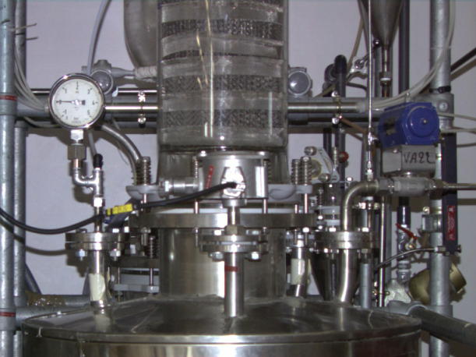
BatchColumn
Detailed modeling of:
  the heating device,
  the condenser/decanter
  the column hydrodynamics (pressure drop, liquid retention, flooding)
Optimization of complex separations (azeotropic mixtures, liquid-liquid-vapor, etc)
Reliable description of the different steps of the operating mode
Fully configurable model (fed-batch, intermediate boilers, etc)
Efficient numerical algorithms

Slide 21

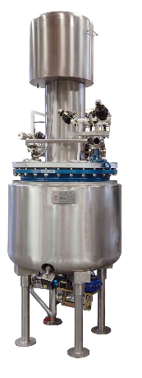
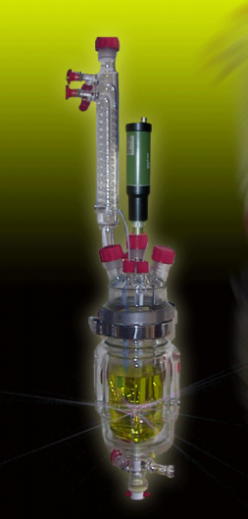
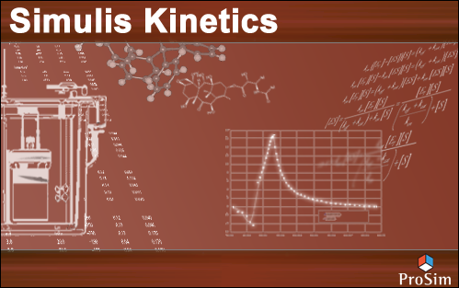
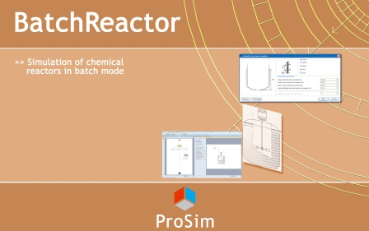

BatchReactor
Useful throughout your process life
Experimental
data
Identification of kinetic
reactions parameters from
experimental data
Reactor model
Industrial Reactor
Reactive calculator
Notes:
21

Slide 22
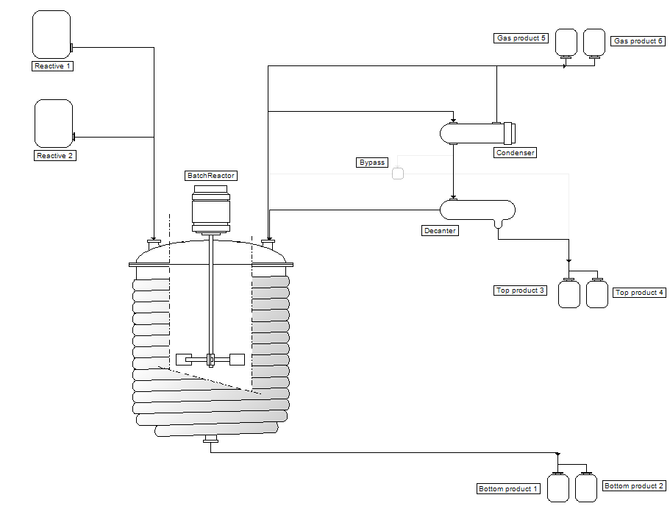
BatchReactor
Accurately represent your equipment
Condenser
Decanter
Heating / cooling system :
Wall heat exchanger : jacket, partial
pipes, inductor
- Internal coil
- External heat exchanger
Mixing system
Vessel

Slide 23
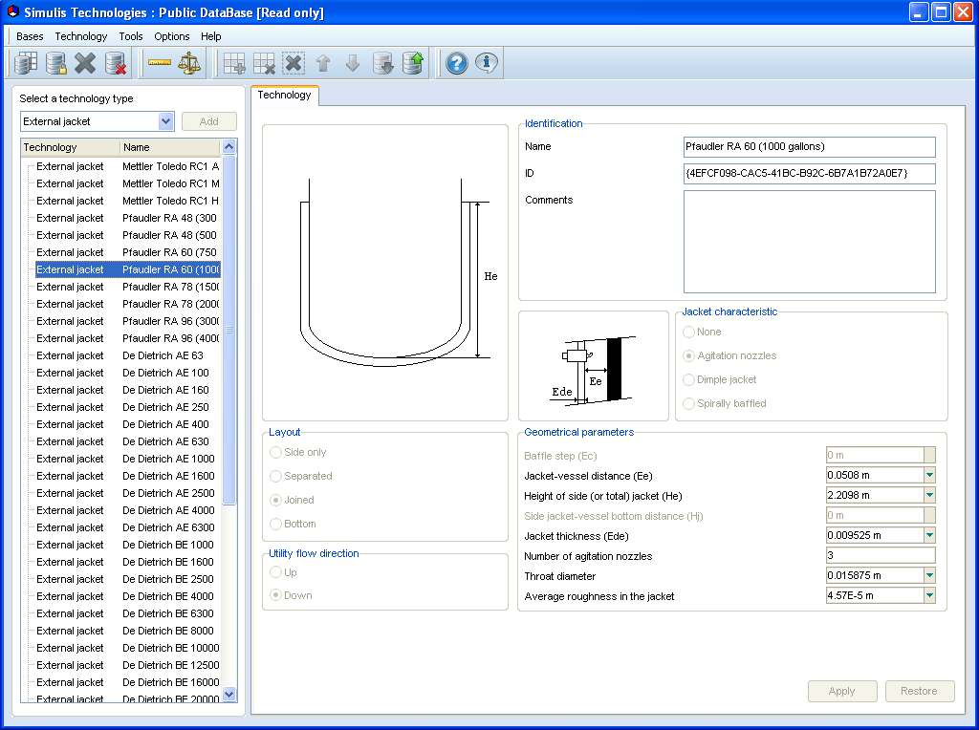
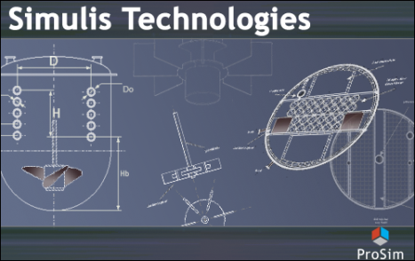
BatchReactor
Manage your technical data
In-built equipment database :
  Vessels
  Agitators
  Wall material
  External jacket
  Partial pipe
  Internal coil
You can create your own private database to store your specific equipment characteristics

Slide 24

BatchReactor
Describe your operating mode
You can manage 5 different categories of steps
Constant heat duty : you provide the heat duty
Variable heat duty: duty depends on the thermal device
Specified Temperature Reactor (TR) without cooling/heating devices: isothermal or fixed profile of temperature
Specified Temperature Reactor (TR) with cooling/heating devices: you’ll obtain the utility flowrate or utility temperature
Specified Temperature Jacket (TJ): duty depends on the jacket or partial pipe system

Slide 25
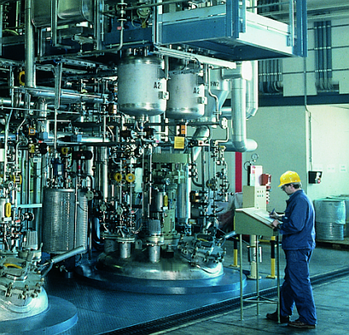
BatchReactor
Time-saving in scale-up phases
Optimization of batch yields and time
Risk management (highly exothermal reactions, failure consequences analysis, etc.)
Kinetic parameters fitting from lab data
Detailed modeling of the cooling/heating device
Detailed description of the recipe (states and events)

Slide 26
A consistent suite of software
… the premium alternative in process simulation

Slide 27

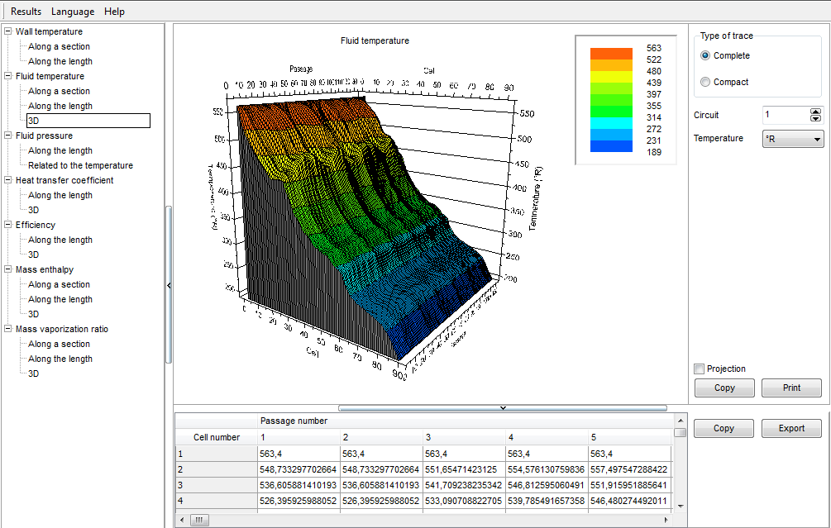
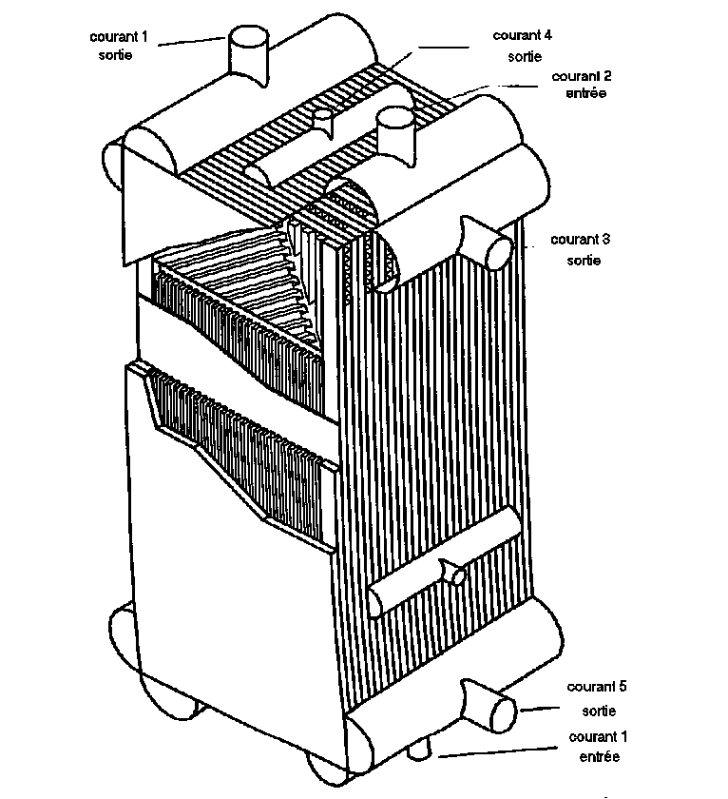
ProSec
Complex "plate fin" heat exchangers simulation

Slide 28
A consistent suite of software
… the premium alternative in process simulation

Slide 29

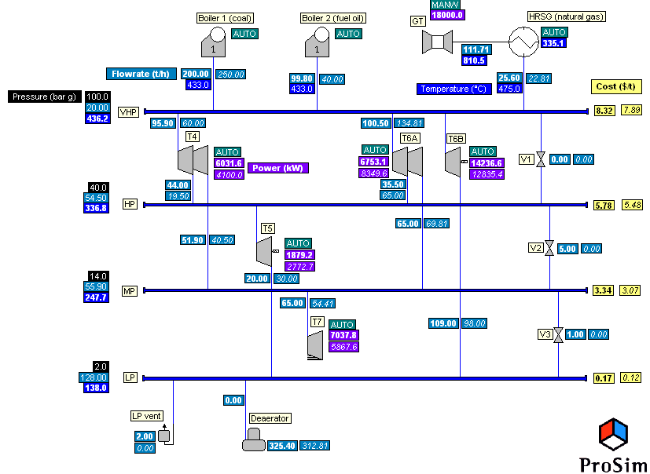

Ariane
Economic optimization of utilities production
In design : to reduce investment risks in a power plant
Operation:
  automatic determination of the lowest operating cost
  Efficient management of pollutants release
In management: Assessment and evaluation of contract options
"Off-line" or "on-line" decision support tool

Slide 30
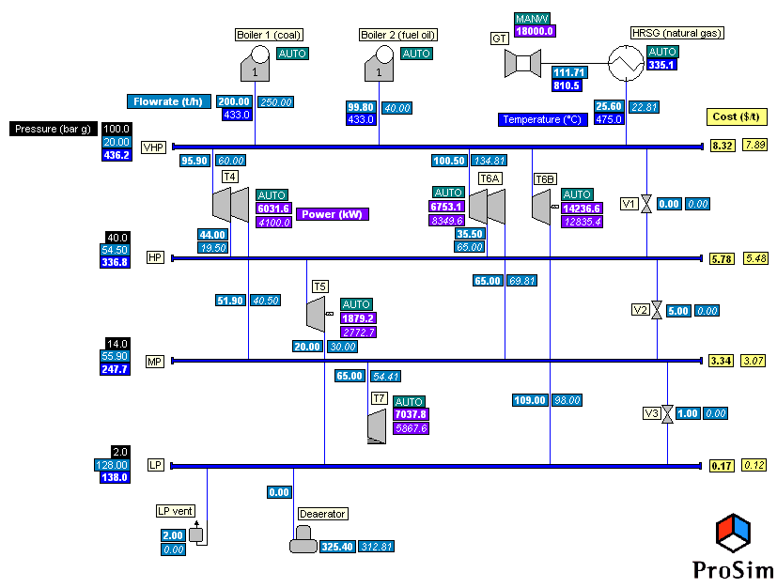
Purpose of Ariane®
Power plant
Taking into account:
costs of purchased electricity and fuels
Constraints (environmental, technical…)
Knowing the power need: steam flowrate (P), hot water flowrate (T)…
You obtain:
  the right operating configuration (stop of such boiler, start of such turbine,…)
  the optimum operating parameters of the plant (steam flowrate sent to turbine, boiler output temperature…)
…to reach the lowest operating cost
Notes:
Basically, Ariane determines the best operating configuration by indicating which boiler ad/or which turbine should be stopped or started.
It also gived the optimum operating parameters of the plant, such as the optimum boiler output temperature, optimum flosrate to send to the turbine
And this information is calculated from the need in steam and hot water of the industrial site, taking into account :
the price of the various fuels and of the electricity purchased
And also all the technical, environmental and operational constraints.

Slide 31
Ariane® in a nutshell
What it is…
Ariane® is a decision support tool dedicated to the management of power plants that produce utilities (steam, hot water, electricity…) from a variety of fuels.
What it does…
It helps identify, reach and remain at the optimal operating configuration by providing an in-depth and accurate understanding of both technological and economical aspects of utilities production.
How it does it…
It uses powerful modeling and optimization methods to calculate the optimal production point, even on the most complex installations.
Notes:
In a few words,
Ariane helps to make decision when managing plants that produce utilities from different fuels.
It gives the optimal operating conditions and configuration thanks to a comprehensive analysis of economical and technical aspects of utilities production/
To reach this goal, even on very large and complex units, powerful modeling and optimization methods are used.

Slide 32


A wide range of services
Maintenance, Upgrades, Training and Support
  Your questions are our daily challenges!
  … you’re not alone with the software.
Studies | Consulting
  Process studies through modeling and simulation
  Application implementation and software extension
  Specific software applications development
  Support and maintenance of "legacy" codes
  Benefit from our experts passion and knowledge

Slide 33


1- Maintenance, update, training & support
Training
  Standard or custom training (on-site or public)
  Training included in MUTS Services agreement
  Registered training company
MUTS Services
  Advice on thermodynamic models selection
  Research of missing data
  Modeling expertise
  Solution of process issues
  Simulation convergence problems
  "Hints and tips" for using efficiently the software
  etc…
…provided directly by ProSim experts
You're supported to make the most of the software & get very short return on investment

Slide 34

2- Process studies & applications consulting
Process Development
Front-end engineering
Studies – R & D
Engineering
Production
Research of missing data
Process study and analysis
Operating optimization
Thermodynamic models
Batch vs continuous
Units debottlenecking
Parameters fitting
Cost estimation
"On-line" optimization
Kinetic models
Equipment sizing
Dynamic simulation
Physical phenomenon study
Scale-Up
Process safety
Experimental tests management
Operating limits
Etc…
You can focus on your priorities while your process studies are done by our experts

Slide 35

Some examples of process studies…
Design of deethanizer and demethanizer columns
Analysis and design of a solvent recovery unit
Modeling and design of an atmospheric distillation tower
Real-time dynamic simulation of an Acetone Cyanhydrin plant in order to optimize the operation
Heat integration analysis of the heat exchanger train of a refinery
Thermal runaway simulation of a batch reactor in order to analyze the safety parameters
Design by simulation of a ethyl lactate recovery distillation unit
Process book for a high purity carbonates production unit
Design by simulation of an ammonia plant
Notes:
Pour illustrer notre activité d'études de procédés par la simulation et la modélisation, j'ai donné ici le titre des derniers projets que l'on a mené pour le compte d'industriels.
⇨ lire
⇨ lire
Une étude sur la pressurisation d'un réservoir de vol de satellite par liquide volatil. Il nous a paru intéressant de vous présenter ce projet car d'une part il est original. D'autre part il montre comment on a pu associer des essais expérimentaux qui ont été sous-traités à différents partenaires et de la modélisation.

Slide 36

3- Application implementation & software extensions
Model building, tuning and validation
Customized model interfaces
ProSim software functionalities enhancement
Integration of proprietary unit operations or user defined thermodynamic models in ProSim sw
Conversion of competitor models to ProSim products
Transfer of simulation results to other applications
etc…
Get what you need
Notes:
Pour illustrer notre activité d'études de procédés par la simulation et la modélisation, j'ai donné ici le titre des derniers projets que l'on a mené pour le compte d'industriels.
⇨ lire
⇨ lire
Une étude sur la pressurisation d'un réservoir de vol de satellite par liquide volatil. Il nous a paru intéressant de vous présenter ce projet car d'une part il est original. D'autre part il montre comment on a pu associer des essais expérimentaux qui ont été sous-traités à différents partenaires et de la modélisation.

Slide 37
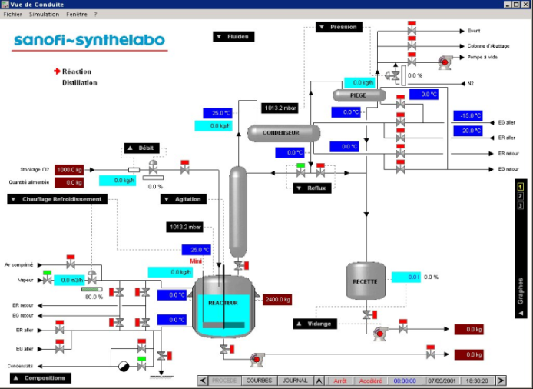
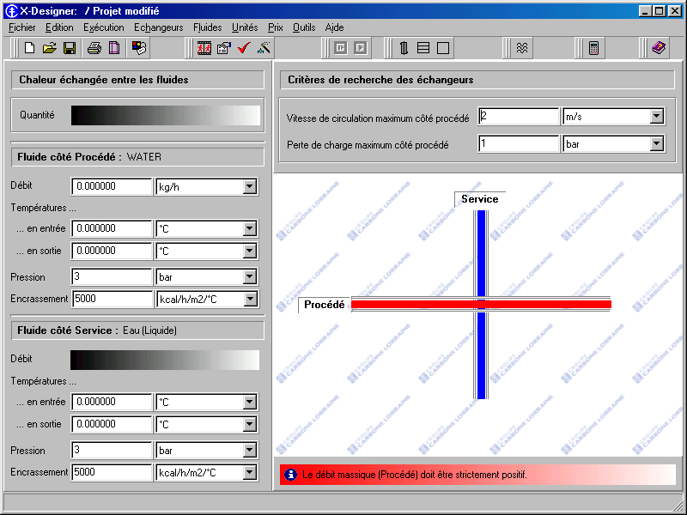

4- Specific software application development
Development of a software for calculation and selection of heat-exchangers
Development of a software for operators training
Development of a software for the management of gas capacities filling
Notes:
La seconde facette de notre activité en prestations de service est le développement de logiciels spécifiques, "à façon".

Slide 38
5- Support and maintenance of legacy codes
Audit and revamping of "internal" codes
Implementation of codes in new environments
CAPE-OPEN standards compatibility
Improvement of numerical methods
Development of new Graphical User Interfaces
etc…
Notes:
En ce qui concerne le développement de logiciels spécifiques ceux-ci peuvent aller du développement d'une Interface Homme/Machine sur un logiciel interne au développement complet d'un nouvel outil depuis les aspects modèles jusqu'aux aspects IHM.
Par exemple il s'agissait ici d'un logiciel de formation d'opérateurs sur une unité de chimie fine. Donc un environnement de simulation dynamique.

Slide 39

Your specificity is our priority
Flexible software solutions that can be fitted to your activity
  Add your knowledge
  Adapt it to fit your needs
  Ask for only what you’ll really use
Flexible licensing policy to match with your specific projects
  Adapted licensing periods
  Evolving agreements
  Supporting academic research and education
Notes:
Flexible software : open solutions to value your knowledge, the contents to fit your needs, obtain exactly what is necessary in your activity (adaptation of contents, implementation of features…).
Business model :
Industry is constantly evolving, investment budgets are fluctuating and services are essential = we propose a ‘Software as a Service’ business model. With this license + services approach:
- You can adapt your software expenses to the duration of your projects;
- You are sure that that you always have the latest versions of our software;
- You have the flexibility of adding or removing licenses over time;
- You benefit from our premium services: support, training, application examples ... as long as your subscription remains active.
This value-added solution allows our customers full access to ProSim’s Support team throughout the entire duration of their contract.
Since its creation in 1989, ProSim has developed close and long term relationships with many universities, research centers and other establishments with educational vocation. This is a good mean for ProSim to share knowledge and gain visibility, helping academid research centers and suporting the training of future engineers.
Universités = vecteurs de notoriété

Slide 40

Why choosing ProSim?
Validated suite of software including unique solutions (ProSimPlus HNO3, BatchReactor, ProSec,…)
Recognized quality of services
thanks to an experienced and passionate team
Continuously improved software to prepare the future
  A clear development strategy
  A network of prestigious partners
  Huge investments in R&D

Slide 41


Why choosing ProSim?
Growing player
  Attractive prices and licensing policy
  Loyal clients
  More companies change for ProSim solutions
A company built to last
  A motivated team
  Stable shareholders
  A very sound financial situation
The right company to build a long-term relationship

Slide 42
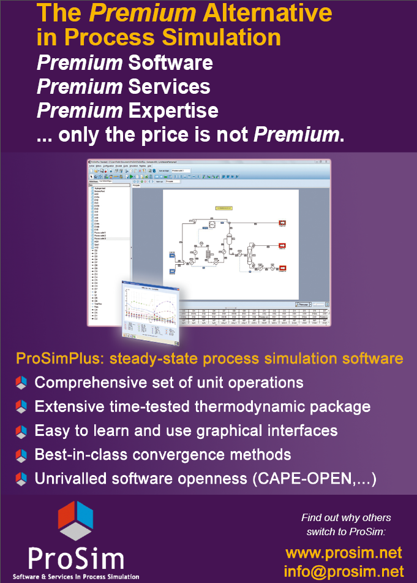
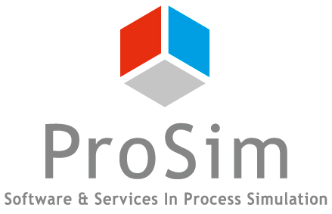
ProSim:
The Premium Alternative in Process Simulation
Notes:
This why ProSim is today the premium alternative in Process Simulation

Slide 43










































Over 880 clients in 71 countries
Notes:
En ce qui concerne notre clientèle une de ses principales caractéristiques est sa fidélité. Et nous en tirons une certaine fierté.
Compte tenu de la taille de nos concurrents Nord-Américains notre accès au marché est difficile. Par contre lorsqu'on a gagné un nouveau client on le conserve, c'est que quelque part il ne doit pas être trop mécontent des services rendus et du rapport qualité/prix.
Je pense qu'il y a les logos de la plupart d'entre vous. Par contre ne vous vexez pas s'il n'y a pas celui de votre société, je ne prétends pas avoir mis celui de tous nos clients.
Je n'ai pas mis ici non plus les logos des écoles d'ingénieurs ou universités qui utilisent nos logiciels en enseignement. Sachez qu'ils sont également nombreux et il y a d'ailleurs certains représentants dans la salle.

Slide 44
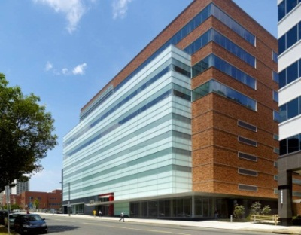
Thank you for your attention!
… any question?
ProSim
Software Solutions for Process Modeling,
Simulation and Optimization
www.prosim.net
info@prosim.net
ProSim SA
51, rue Ampère
Immeuble Stratège A
F-31670 Labège Cedex
France
Phone: +33 (0) 5 62 88 24 30
Fax: +33 (0) 5 62 88 24 39
ProSim, Inc.
Science Center
3711 Market street, 8th floor
Philadelphia, PA 19104
U.S.A.
Phone: +1 215 600 3760
Fax: +1 215 386 3970
Authorized representative
NTP Truboprovod
Plekhanova str., 7
111141 Moscow
RUSSIA
Tel: +7 495 225 9435
Fax: +7 495 368 5065
www.truboprovod.ru
info@truboprovod.ru
Notes:
Remercier ASPO et M. Berezin

